Slide 1
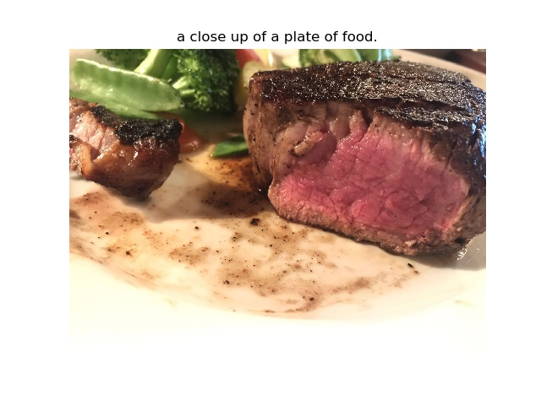
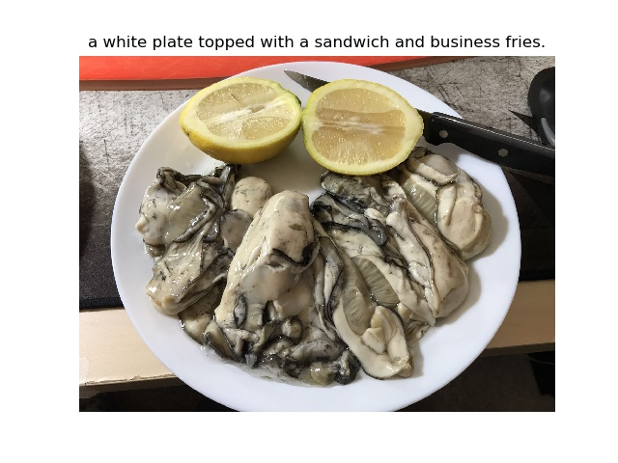
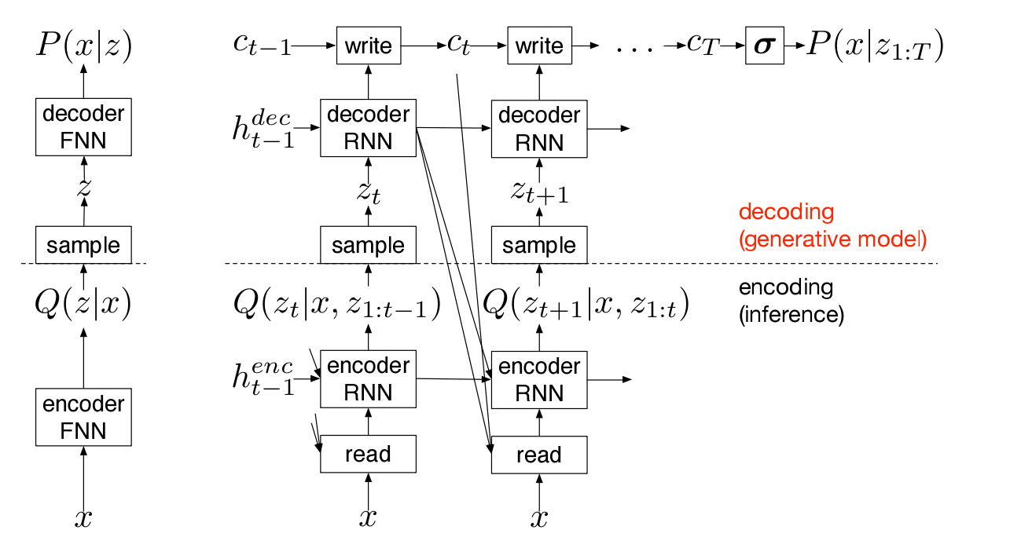
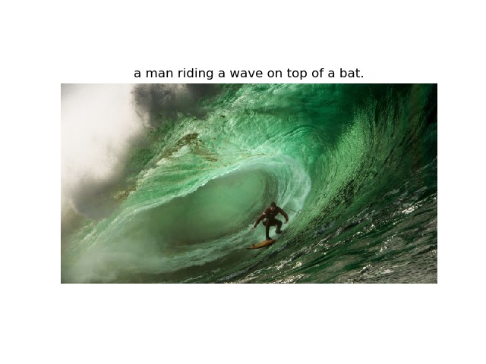
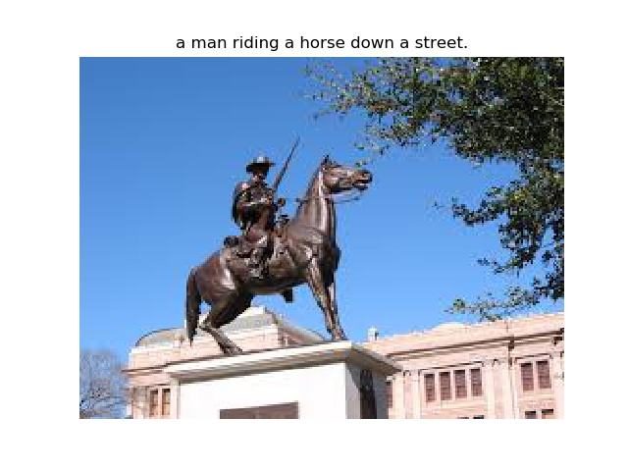
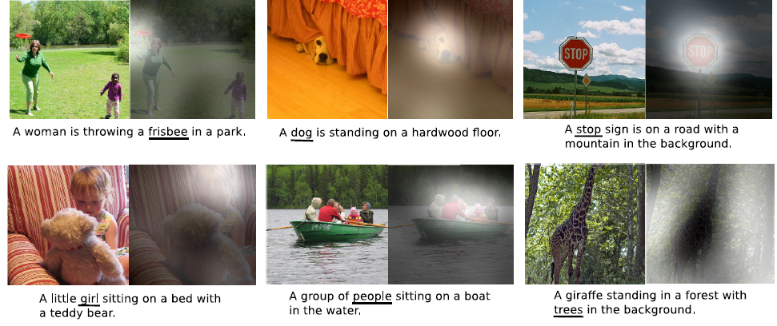

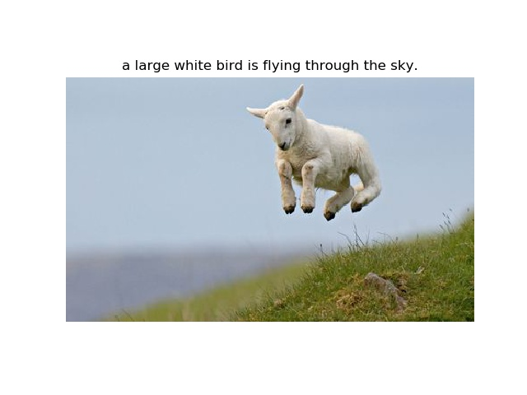
MATH 6980O Project II: Imagine Caption with Attention Mechanism
Ye Yushi and Mao Hongyu {yyeaf, hmaoab }@ust.hk
Department of Mathematics, HKUST
1. Introduction
interaction method (linear, tanh activation etc). Soft attention is adopted here as soft model works better with METEOR score, and we believe that METEOR is a more fair scoring method while BLEU tend to lose sentence generality. COCO used as test dataset and the model structure show as follows:
Also we find that the model tend to fail if the image is not narrative.
After comparing the images above with similar data in COCO, we believe that this is caused by lack of correspondence between objects in image. Or even there is only one main object in the image, attention mechanism fails under these scenarios as it cannot find any useful connections in the image, which leads to a chaos output in the decoder output. The overall BLEU/METEOR are listed here:
Attention mechanism is a great improvement in NLP field. Before the attention is introduced, bilingual translation is usually based on seq2seq RNN model. But the naïve RNN model tend to have long-dependency issue. Even after we use LSTM cell instead, it is still very hard for the model to capture connections between words for sentences longer than 20 words.
The attention mechanism tries to give a musk (in other words, weights) on the input stream by aligning up every word in the sentence with last output, so that the model will focus more on the words that have stronger correlation with the next potential output. By this method the translation quality is greatly improved in terms of both BLEU and METEOR score.
Imagine Caption is a direct implementation of seq2seq model with Attention, but on Computer Vision filed. The main idea is to change the input stream to sequence of convolutional outputs from image data。
4. Performance and Analysis
Dataset | BLEU-1 | BLEU-1 | BLEU-1 | BLEU-1 | METEOR
COCO | 71.1 | 49.6 | 33.9 | 24.1 | 24
2. Our Attention Model
6. Future work
Our project try to replicate the former work done by Kelvin Xu[1], which implemented VGG as feature extraction layer and introduced both hard and soft attention algorithms to generate caption by using one-hot prediction.
We can see that the caption results are reasonable and fluent in terms of language.
Based on Kelvin’s work, we make some changes including Res-Net instead of VGG, and a 2-layer dense connection instead of classical aligning or
In Kelvin’s work the word prediction is made by using one-hot representation, which means each word is represented by a sparse 0-1 vector. This requires precise prediction of distribution as any weights assigned to other words could be fatal to the model. We suggest to use word2vec so that each word can be embedded into a high-dimensional space and we use MSE error to update the model. Prediction should be based on the nearest neighbor principal. The mechanism may help the caption model to be more flexible as it is not limited to one specific word as target, but all relevant synonyms.
Here are two test examples that make sense. The model describes the imagine precisely and the words are well organized. But the model does not work so well on every image, actually sometimes it misses up the object in the figure if the object does not show in the normal way. The reasons might because the images are not specifically labeled in COCO
and the numbers of each category are fewer compared to dataset like ImageNet.
7. References
1] Kelvin Xu, Jimmy Ba et. al, Show, Attend and Tell: Neural Image Caption Generation with Visual Attention, arXiv:1502.03044
[2] Dzmitry Bahdanau, KyungHyun Cho, Yoshua Bengio, Neural Machine Translation by Jointly Learning to Align and Translate, ICLR 2015
[3] Elman Mansimov, Emilio Parisotto, et al, Generating Images from Captions with Attention, arXiv:1511.02793

